Slide 1
Title Layout
Subtitle

Slide 2
Title and Content Layout

Slide 3
Two Content Layout
The quick brown fox jumps over the lazy dog.
The quick brown fox jumps over the lazy dog.
The quick brown fox jumps over the lazy dog.
One
Two
Three
Four
Five
Six

Slide 4
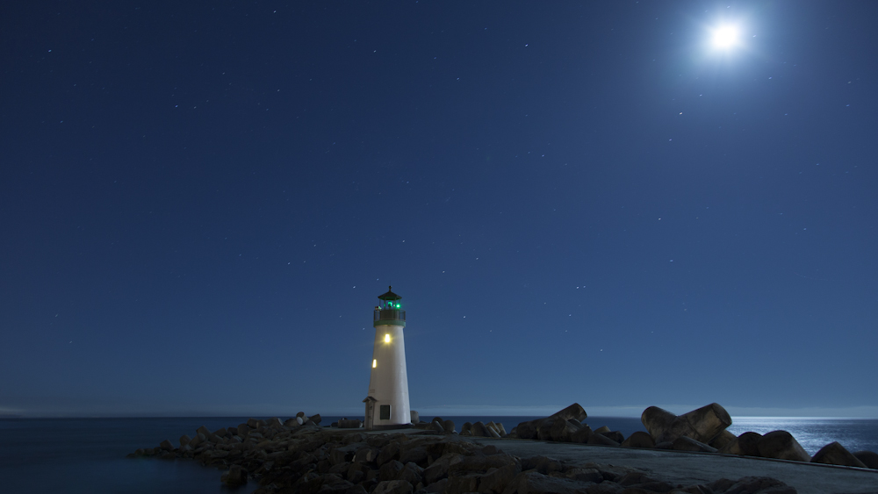
Photo Layout
Santa Cruz Lighthouse

